Slide 1
Data frame

Slide 2
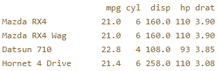
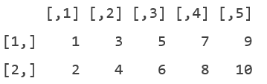
What's a data frame?
A data frame has the variables of a data set as columns and the observations as rows.
data frame
matrix

Slide 3
mtcars
head(mtcars)
tail(mtcars)
str(mtcars)
structure of your data set

Slide 4
Creating a data frame
# Definition of vectors
name <- c("Mercury", "Venus", "Earth", "Mars", "Jupiter", "Saturn", "Uranus", "Neptune")
type <- c("Terrestrial planet", "Terrestrial planet", "Terrestrial planet",
"Terrestrial planet", "Gas giant", "Gas giant", "Gas giant", "Gas giant")
diameter <- c(0.382, 0.949, 1, 0.532, 11.209, 9.449, 4.007, 3.883)
rotation <- c(58.64, -243.02, 1, 1.03, 0.41, 0.43, -0.72, 0.67)
rings <- c(FALSE, FALSE, FALSE, FALSE, TRUE, TRUE, TRUE, TRUE)
# Create a data frame from the vectors
planets_df <- data.frame( name, type, diameter, rotation, rings)
planets_df
str(planets_df)

Slide 5
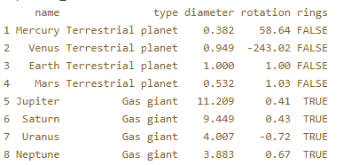
Selection of data frame elements
# Print out diameter of Mercury (row 1, column 3)
planets_df[1,3]
planets_df[4, ]
planets_df[6:8, "diameter"]
planets_df[ , "type"]
[row, column]

Slide 6
Selection of data frame elements
# Print out diameter of Mercury (row 1, column 3)
planets_df[1,3]
planets_df[4, ]
planets_df[6:8, "diameter"]
planets_df[ , "type"]
planets_df$type
[row, column]

Slide 7
條件篩選
subset(planets_df, subset = diameter < 2)
subset(planets_df, subset = rings )
subset(planets_df, subset = name ) ➔ 只能是 logical型態

Slide 8

Sorting
a <- c(100, 10, 1000)
order(a)
a[order(a)]

Slide 9

Sorting data frame
positions <- order(planets_df$diameter)
根據 diameter 排序
planets_df[positions, ]

Slide 10
Summary
Vectors (one dimensional array): can hold numeric, character or logical values. The elements in a vector all have the same data type.
Matrices (two dimensional array): can hold numeric, character or logical values. The elements in a matrix all have the same data type.
Data frames (two-dimensional objects): can hold numeric, character or logical values. Within a column all elements have the same data type, but different columns can be of different data type.

Slide 11
List

Slide 12
list()
# Vector with numerics from 1 up to 10
my_vector <- 1:10
# Matrix with numerics from 1 up to 9
my_matrix <- matrix(1:9, ncol = 3)
# First 10 elements of the built-in data frame mtcars
my_df <- mtcars[1:10,]
# Construct list with these different elements:
my_list <- list(my_vector, my_matrix, my_df)
my_list

Slide 13

list() 加上別名
# Vector with numerics from 1 up to 10
my_vector <- 1:10
# Matrix with numerics from 1 up to 9
my_matrix <- matrix(1:9, ncol = 3)
# First 10 elements of the built-in data frame mtcars
my_df <- mtcars[1:10,]
# Adapt list() call to give the components names
my_list <- list(vec = my_vector, mat = my_matrix, df = my_df)
my_list

Slide 14
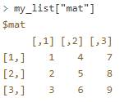

用別名取出元素
my_vector <- 1:10
my_matrix <- matrix(1:9, ncol = 3)
my_df <- mtcars[1:10,]
my_list <- list(vec = my_vector, mat = my_matrix, df = my_df)
my_list["mat"]
my_list[["mat"]]
my_list$mat

Slide 15
Add value(s) to the list
my_vector <- 1:10
my_matrix <- matrix(1:9, ncol = 3)
my_df <- mtcars[1:10,]
my_list <- list(vec = my_vector, mat = my_matrix, df = my_df)
my_list <- c(my_list, year = 1980, month = 11)
my_list

